Slide 1
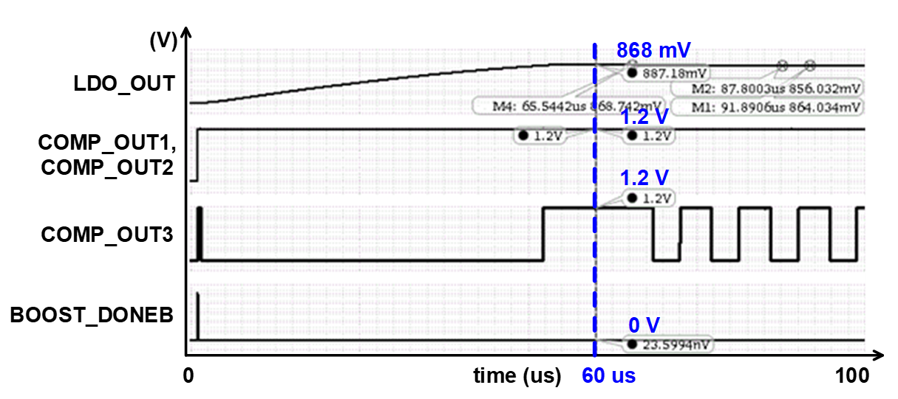
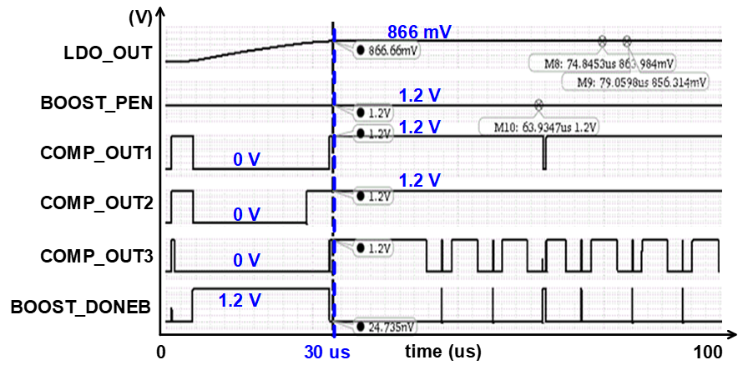
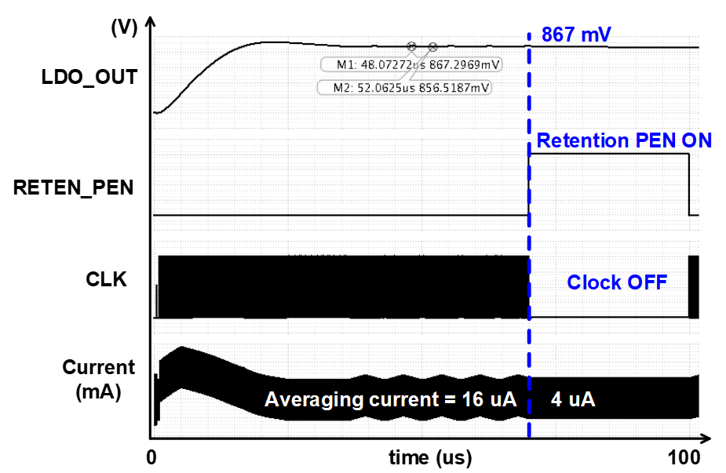
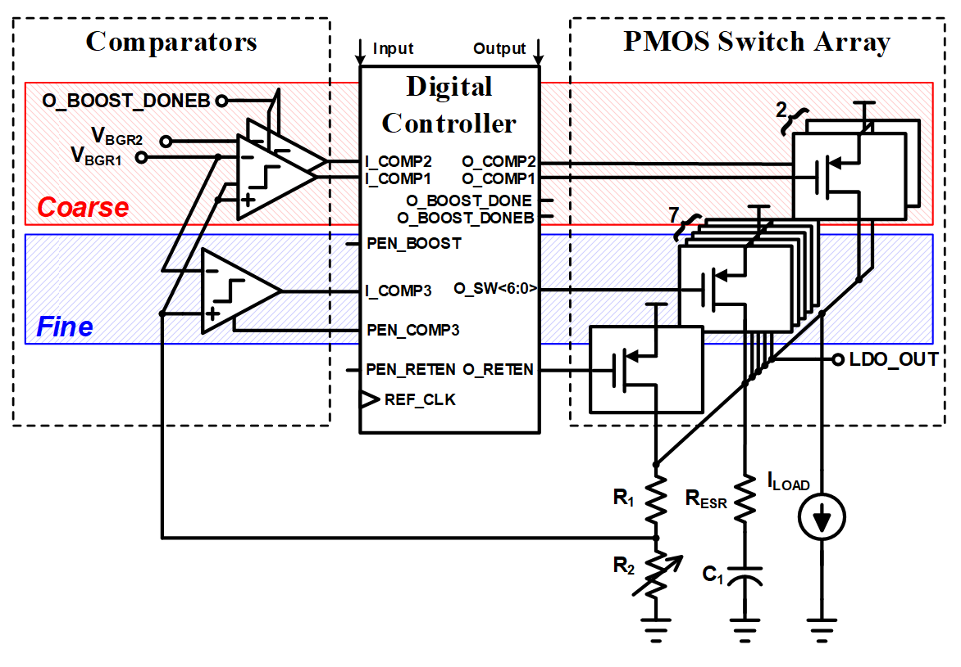
A Design of Digital Feedback LDO Regulator with
Fast Settling Time and Ultra-Low Dropout Voltage
Tae-Wan Kim ¹, Tae-Young Yoon², Sang-Gyu jeon³, Jong-Wan Jo⁴ and Kang-Yoon Lee
Department of Electrical and Computer Engineering, Sungkyunkwan Univ.
Introduction
Structure
1
1
In order to increase the efficiency of the LDO, it is necessary to design a low drop out voltage and low current consumption
This poster discusses the design of a digital LDO with ultra-low voltage drop and a triple-mode technique for low power and fast settling time
< Triple mode transient result>
Structure
The pictures above are listed in order of Normal, Boost and Retention mode
The input voltage range is 0.8 to 1.5V, and when the input voltage is 1V, the output voltage range is 0.746V to 0.956V
The settling time is 60us in Normal mode and 30us in Boost mode
In the retention mode, the digital controller and the comparator are turned off, and only the minimum PMOS is activated to reduce the current consumption by one quarter from 16uA to 4uA. The current efficiency is 99.996% at the maximum
Line regulation is 11.4mV / V, input voltage is regulated from 0.8V, load regulation is 8mV / mA, and regulated to 5mA.
1
< proposed digital LDO Structure >
The comparator compares the reference voltage with the output voltage and turns on off the output transistors one by one in the controller
Components include pass transistors, error amplifiers, a BGR circuit that generates a reference voltage, and a resistor divider
In order to have fast settling time and low current consumption, we implemented a triple mode of Boost, Normal, and Retention
Conclusion
1
we design a digital feedback LDO with three operation modes of Normal, Boost and Retention for low power and fast settling time
To supply power to RF blocks or noise-sensitive blocks, this idea are needed to use a non-clock structure or minimize ripple

